Slide 1
Student Registration Form
Team Details:
Harshita : 2310990601
Moorvi Garg : 2310990659
Faculty Coordinator: Dr.Kirandeep Singh
Chitkara University Institute of Engineering and Technology,
Chitkara University, Punjab

Slide 2
Table of Contents
Introduction
Technologies Used
Frontend
Backend
Project flow
Key Features
Project Highlight

Slide 3
Introduction
Project Overview:
The Student Registration Form project is a web-based application designed to streamline the student registration process. It features a user-friendly interface for submitting admission forms,and a secure backend for efficient data management. This project digitizes and simplifies student registrations while enhancing communication and accessibility.

Slide 4
Technologies Used-
Frontend: HTML, CSS, JavaScript
Backend: Node.js, File System (fs module)
Data Storage: JSON files

Slide 5
Frontend :-
HTML Structure:
Used to create the structure of the forms and pages.
Contains form elements such as input fields, submit buttons, and tables.
User Interaction:
User submits personal information such as name, email, contact number, department, and course.

Slide 6
CSS-
Design and Layout:
Used to style the forms and tables.
Color schemes, fonts, and layout adjustments for a user-friendly interface.
Animations for a smooth transition and engaging experience.

Slide 7
JavaScript-
Dynamic Content Handling:
Fetching data from the backend using the fetch() function.
Populating the table with student information dynamically.
Submitting form data to the backend via POST requests.

Slide 8
Backend -
Server Setup:
http module: Creates a server to handle incoming requests.
fs module: Reads and writes data to a User.json file.
qs module: Parses form data sent in POST requests.
Request Handling:
GET Request: Fetches data from the User.json file and sends it as a response (for displaying all student data).
POST Request: Receives form data, stores it in User.json, and responds with a success page.
Data Storage:
Data is stored in a JSON file (User.json), where each new registration is appended.

Slide 9
Project Flow -
User fills the admission form.
Data sent to server via POST.
Server stores data in JSON file.
User redirected to success page.
Admin can view all student data using the GET request.

Slide 10
Key Features
Responsive Design
User-Friendly Interface
Clear and Organized Content Layout
Interactive Data Display
Success Confirmation
Error Handling
Data Storage Integration
Backend Processing
Integrated Resource Links.

Slide 11
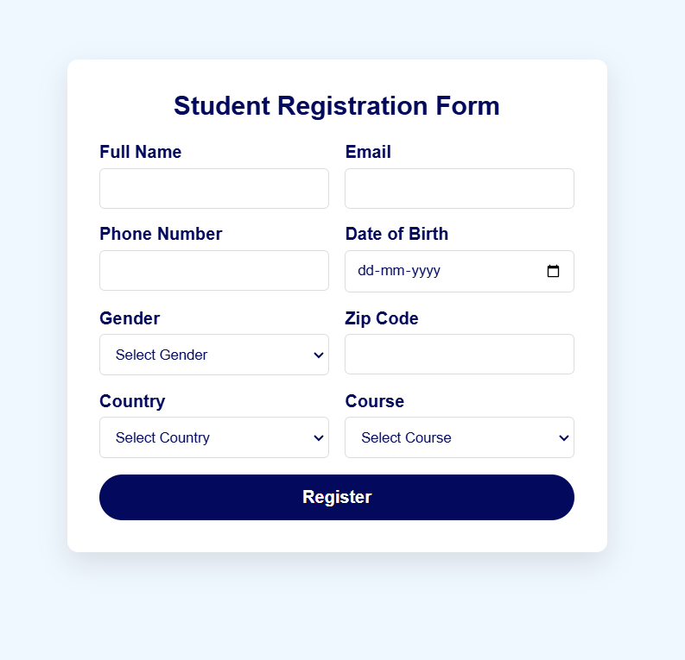
PROJECT HIGHLIGHTS -

Slide 12
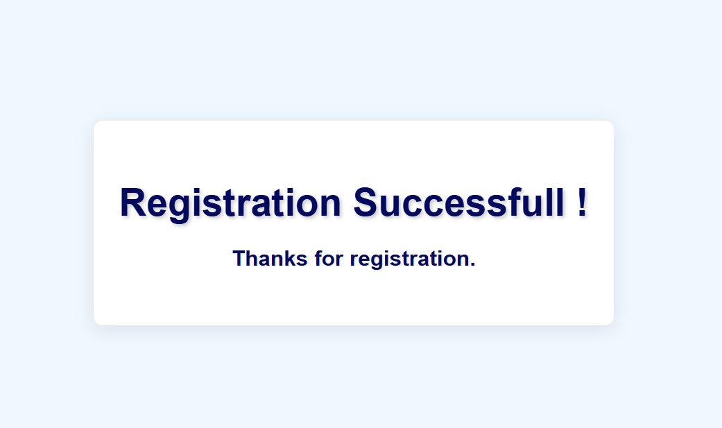

Slide 13
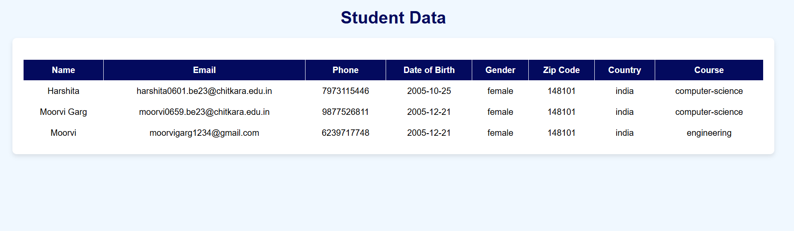

Slide 14


